Slide 1
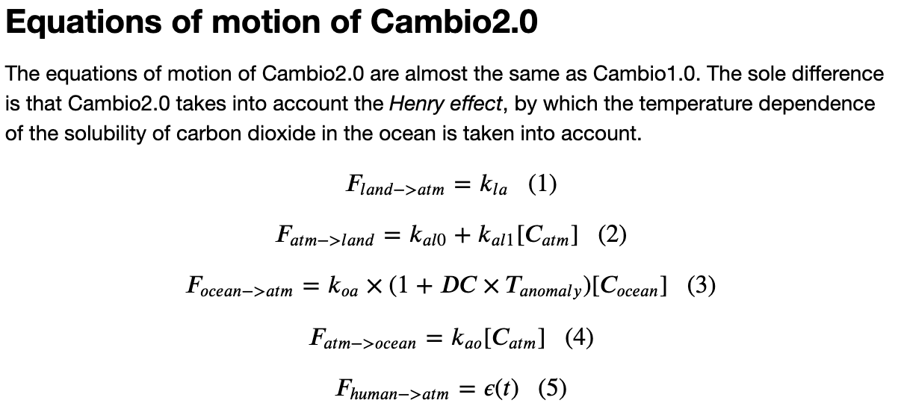

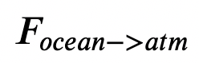
Last time: Why refactor (from Cambio1.0 to Cambio2.0)?
There’s a lot to keep track of (arrays, metadata)
We’re about to make it yet more complex by introducing feedbacks
Cold ocean
Warm ocean
=> it’s a good time to overhaul (“refactor”) how we manage data and algorithms.

Slide 2
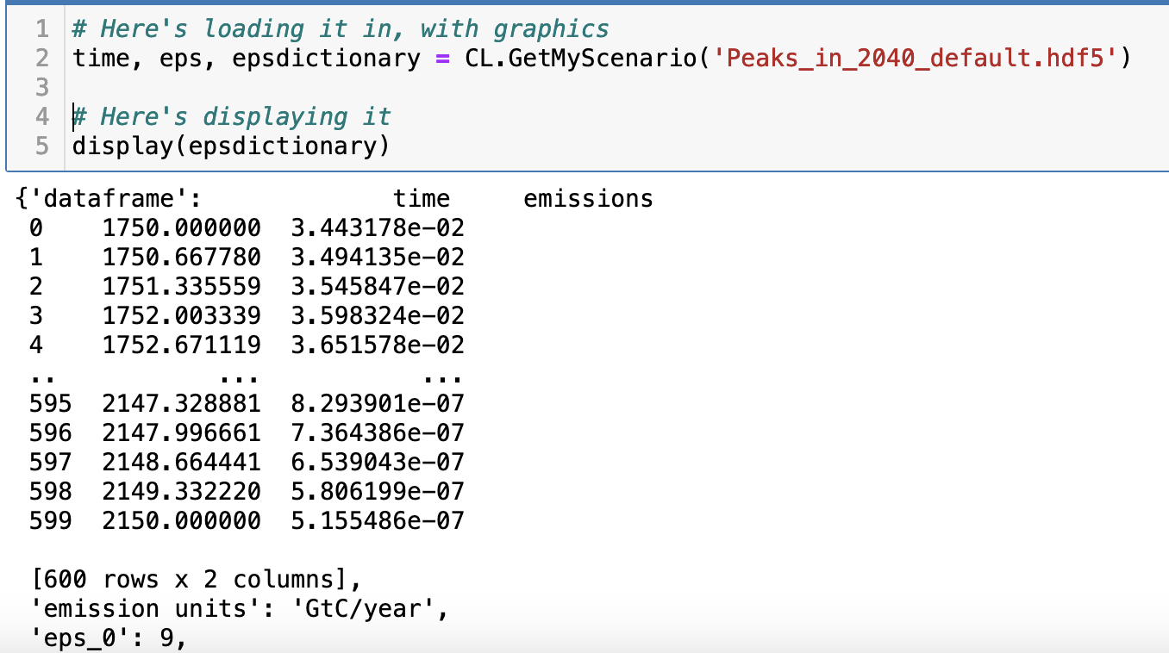
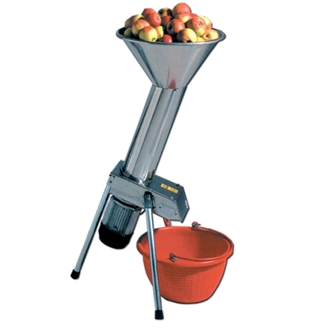
We took a step in this direction by introducing a new function to load emissions scenarios

Slide 3
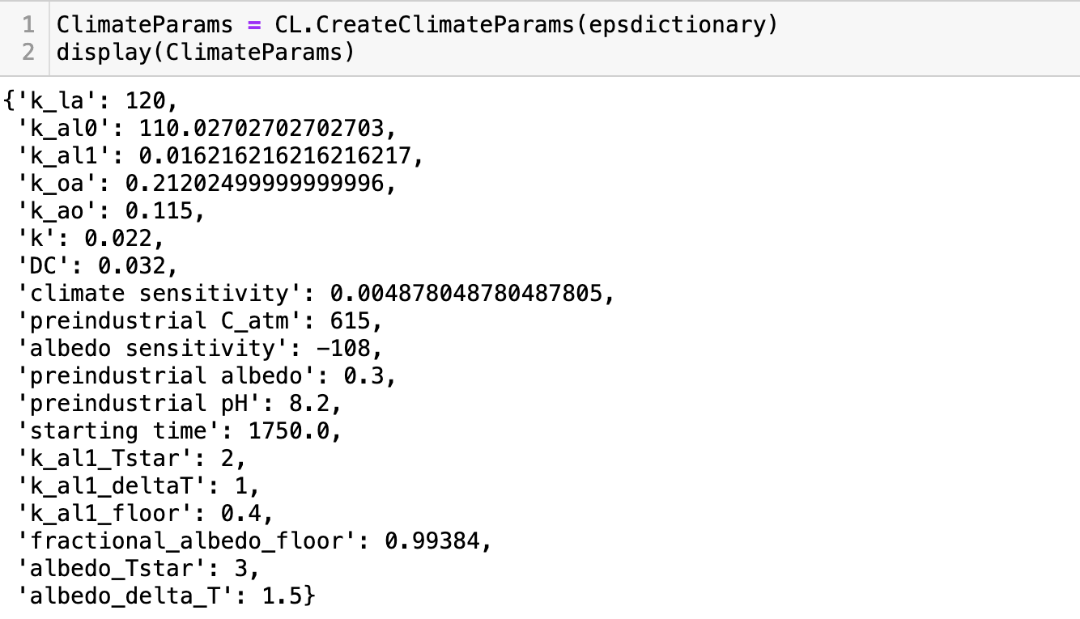

We also introduced a new function that creates a set of climate parameters

Slide 4
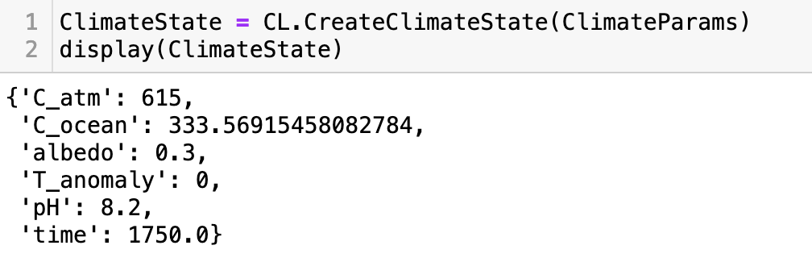

And another function that creates a preindustrial climate state

Slide 5
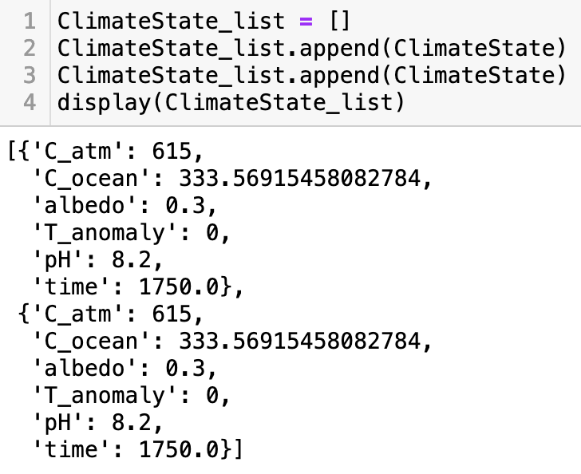
The idea is that we’ll make lists of these climate states, get information out of them later
In this case, the list is just two states long – and very boring because they’re the same climate state.
But later, we’ll be assembling lists of climate states within an Euler loop!

Slide 6
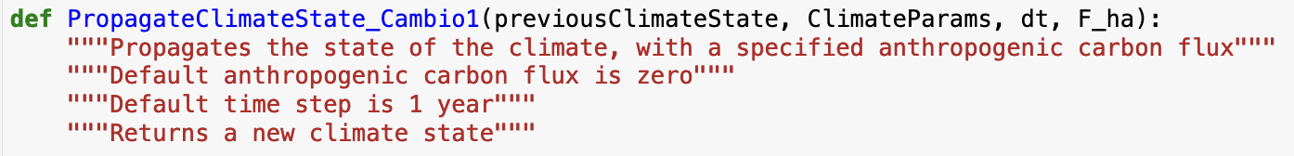


Introducing a climate propagator too
…

Slide 7
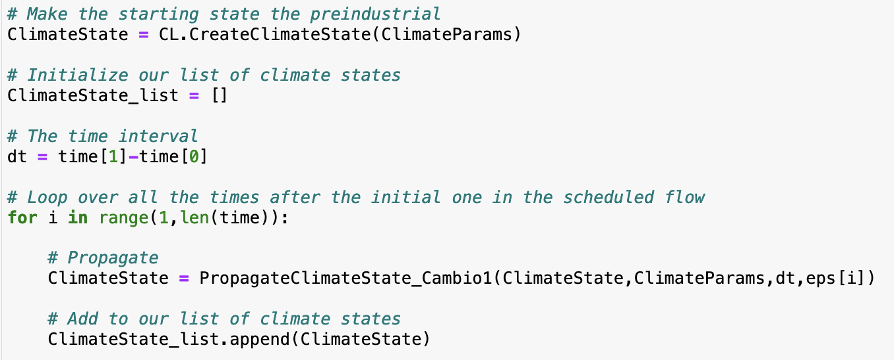
The Euler loop in Cambio2.0

Slide 8
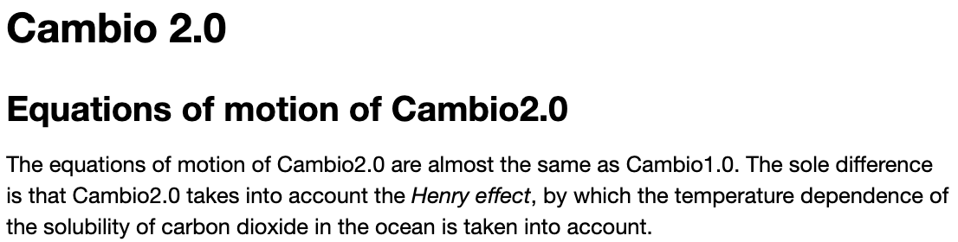
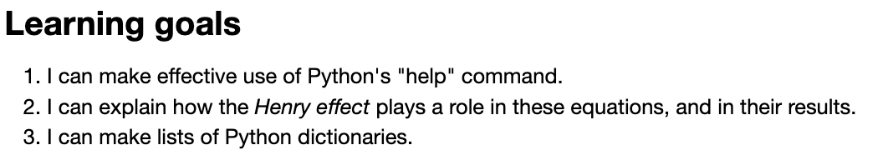
OK, let’s get started
Cold ocean
Warm ocean
Notes:
Predict the temperature if CO2 continues to rise. If we reduce CO2 emissions to zero.

